Slide 1
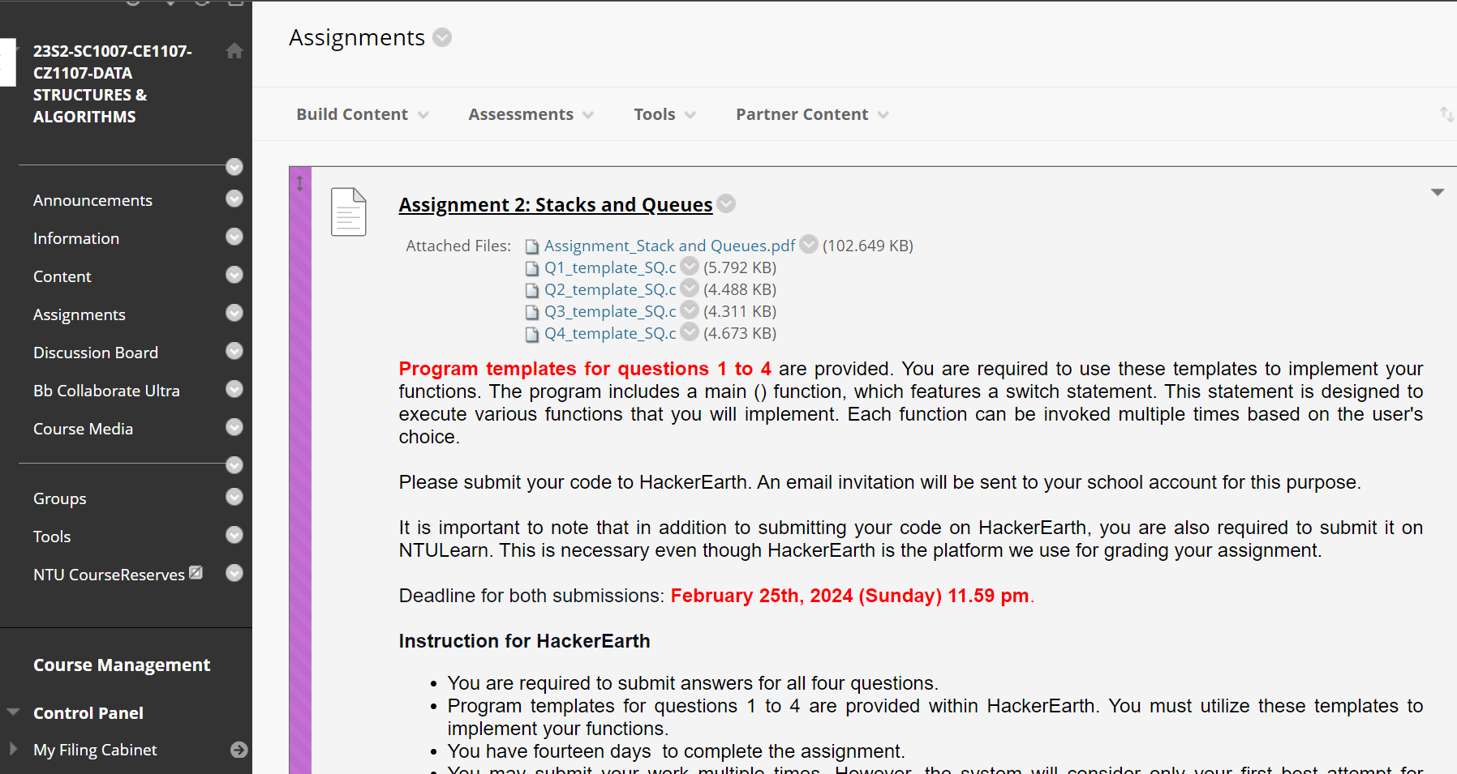
Stack and queue assignment
Hacker Earth link will be sent by Tomorrow

Slide 2
Question 01

Slide 3
Question 02

Slide 4
Question 03

Slide 5
Question 04

Slide 6
Week 05 Labs and tutorial
No Labs and tutorial in week 05
Only make up Labs (Week 04)and Makeup Tutorials (Week 04) will be conducted During week 05

Slide 7
Makeup Labs in week 05
Lab Group | Venue |  | Affected date (Holiday) | Makeup Lab
FCS2 | SW1 |  | Wk4 Fri 09-Feb-24 | Lab shift to Wk 5 (16-Feb-24)
MACS1 | SW1
FCS3 | SPL
FCSE | SPL
FCSB | SWLAB3

Slide 8
Make up Tutorial in week 05
DATE | GROUP | TIME | VENUE | INSTRUCTOR | Link
16/02/2024 | FCSA | 1330-1420 | ONLINE | Althea Liang | https://ntu-sg.zoom.us/rec/share/qMfrh1RkFyuU7QYltuC3CywRADKxF7iq_XK0oQcGBa1d2lvxDvfdMXf9LDFshLfO.9igchFtxe9YsNJoi Passcode: %^S1ZyDn
 | FCS3 | 1230-1320 | ONLINE | Althea Liang
 | FCS5 | 1430-1520 | ONLINE | Althea Liang
 | MACS1 | 1330-1420 | ONLINE | Pan Xingang | https://teams.microsoft.com/l/meetup-join/19%3ameeting_M2I1YjUwOWItNzhjOS00OTJhLWI5MTMtZmJjNjFiYWQ3MDFi%40thread.v2/0?context=%7b%22Tid%22%3a%2215ce9348-be2a-462b-8fc0-e1765a9b204a%22%2c%22Oid%22%3a%2265a33665-3c3a-440b-b716-34c4ae981dbb%22%7d Meeting ID: 448 620 175 132 Passcode: s5NEJG

Slide 9
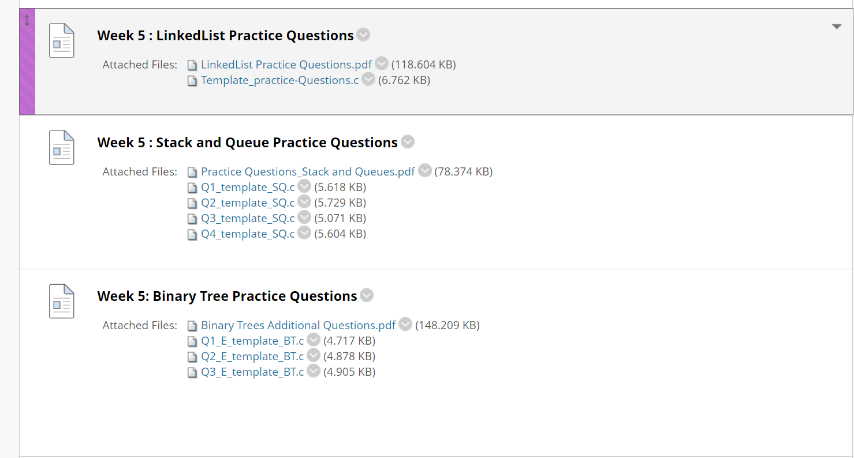
Week 05 Practice Questions

Slide 10
Lab Test 1 (05/03/2023 – 06/03/2024)
Lab Test 1, accounting for 20% of your grade, is scheduled from March 5th to March 6th, 2024. Below, you will find the venues and time slots organized according to your LAB GROUPS:
Venue SWLab2 (N4-1c-06) HWLab2 (N4-1ba-05) HPL (N4-1c-09a) | Full-Time Students (Recess Week)
 | 5 Mar 2024 (Tuesday) |  | 6 Mar 2024 (Wednesday)
 | 9.30 AM – 11.30 AM | 13.30 PM – 15.30 PM | 9.30 AM – 11.30 AM | 13.30 PM – 15.30 PM
SWLab2 – Rm1 | FDAE FCS5 | FCSC FCMA | FCS2 FDAB | FCSH
SWLab2 – Rm2 | ECDS1 | FCED | FCS3 | FCSI
HWLab2 – Rm1 | FCSF | FCSB | FDAD | FCMB
HWLab2 - Rm2 | FCEC | FCEE | FCE1 | FCE2
HWLab2 - Rm3 | FCS7 | MACS1 | FDAA | FDAC
HWLab2 – Rm4 | FCSD | FCEA | FCSG | FCE3
HPL – Rm1 | FCSA | FCEB | ACDA1 | FCS1
HPL – Rm2 | FCCA | FCS4 | FCS6 | FCSE

Slide 11
Lab Test 1 (05/03/2023 – 06/03/2024)
The test consists of five (5) questions, each worth 20 marks.
Questions may cover topics such as Linked Lists, Stacks & Queues, Binary Trees, and Binary Search Trees.
You are required to attempt all five questions.
The duration of the test is 120 minutes.
The test platform is available at HackerEarth.
You are permitted to use Code:Blocks for coding.
This is a closed-book examination. Apart from the computer used for the test, no other materials, notes, or electronic devices are allowed. Access is limited to HackerEarth and Code::Blocks.
Communicating with others during the test is strictly prohibited.
You are not allowed to leave your seat once the test has commenced until it concludes.
Programming templates will be provided for the lab questions.
Participation in this e-assessment signifies your commitment to the University's Honour Code, which can be found at NTU Honour Code ((https://www.ntu.edu.sg/sao/pages/honourcode.aspx).
In case of absence, you must submit valid documentation (e.g., Medical Certificate) to justify your absence by 4:59 PM on March 6, 2024, to ofernando@ntu.edu.sg. Failure to provide documentation will result in a zero mark for the test.

Slide 12
LAB TEST FORMAT
Question No | Lecture Module | Description
1 | Linked List | From Labs, Tutorials, Assignments, and practice questions
2 | Linked List | Unknown Question
3 | Stacks and Queues | From Labs, Tutorials, Assignments, and practice questions
4 | Stacks and Queues | Unknown Question
5 | Binary Trees and Binary Search Trees | From Labs, Tutorials, Assignments, and practice questions

Slide 13

Outline
Non-linear data structures
Tree data structure
Binary trees
Implement binary tree nodes in C
Binary Tree Traversal
Tree traversal order
Pre-order
In-order
Post-order
Application examples
Count nodes in a binary tree
Find grandchild nodes
Calculate height of every node
Level-by-level traversal
Preorder traversal with a stack

Slide 14
Level-by-level: breadth-first search
begins at the root and explores as far as possible along each branch before backtracking
E.g. the post-order traversal
begins at a root node and inspects all its children nodes. Then for each of those children nodes in turn, it inspects their children nodes, and so on.
Depth-first search
Breadth-first search
Notes:
There are two types of searching mechanisms.
Depth - first search
Breadth – first search

Slide 15
Level-by-level tree traversal
Level 1
Level 2
Level 3
Level 4
Level 5
H
E
L
B
F
J
M
A
C
G
I
K
D

Slide 16
Level-by-level tree traversal
Hint: Make use of another data structure
Nodes stored in order accessed in tree…
Level 1
Level 2
Level 3
Level 4
Level 5
H
E
L
B
F
J
M
A
C
G
I
K
D

Slide 17
Level-by-level tree traversal
Use a queue! Root node should be first
Nodes stored in order accessed in tree
Level 1
Level 2
Level 3
Level 4
Level 5
H
E
L
B
F
J
M
A
C
G
I
K
D
Notes:
I have a queue which is capable of holding binary tree nodes
You need to change the internal node structure then your queue can hold binary tree nodes.

Slide 18
Level-by-level tree traversal
Enqueue the root, H
Level 1
H
Level 2
E
L
Level 3
B
F
J
M
H
Level 4
A
C
G
I
K
Level 5
D

Slide 19
Level-by-level tree traversal
Enqueue the root, H
Dequeue H, and enqueue H’s children
Level 1
H
Level 2
E
L
Level 3
B
F
J
M
E
L
Level 4
A
C
G
I
K
Level 5
D
H

Slide 20
Level-by-level tree traversal
Enqueue the root, H
Dequeue H, and enqueue H’s children
Dequeue E, and enqueue E’s children
Level 1
H
Level 2
E
L
Level 3
B
F
J
M
L
B
F
Level 4
A
C
G
I
K
Level 5
D
H
E

Slide 21
Level-by-level tree traversal
Enqueue the root, H
Dequeue H, and enqueue H’s children
Dequeue E, and enqueue E’s children
Dequeue L, and enqueue L’s children
Level 1
H
Level 2
E
L
Level 3
B
F
J
M
B
F
J
M
Level 4
A
C
G
I
K
Level 5
D
H
E
L

Slide 22
Level-by-level tree traversal
Enqueue the root, H
Dequeue H, and enqueue H’s children
Dequeue E, and enqueue E’s children
Dequeue L, and enqueue L’s children
Dequeue B, and enqueue B’s children
Level 1
H
Level 2
E
L
Level 3
B
F
J
M
F
J
M
A
C
Level 4
A
C
G
I
K
Level 5
D
H
E
L
B
Notes:
I don’t touch level 3 nodes until I process level 2 nodes.
Similarly, I don ‘t process level 2 nodes until I finished processing level 1 nodes.

Slide 23
Level-order Tree Traversal
Write an iterative C function levelOrderTraversal prints a level-by-level traversal of the binary tree using a queue, starting at the root node level.
Note that you should only use enqueue() or dequeue() operations when you add or remove integers from the queue. Remember to empty the queue at the beginning, if the queue is not empty.
void levelOrderIterative(BSTNode *root);

Slide 24
concept
1) Create an empty queue q
2) If tree is not empty, then Enqueue root to the Queue
3) Repeat until Queue is empty
a) Dequeue node’s data from the queue and print it
b) Enqueue node’s left child to the q
c) Enqueue node’s right child to the q

Slide 25
concept
Level-by-level: breadth-first search
Begins at the root and explores as far as possible along each branch before backtracking
E.g. the post-order traversal
Depth-first search
Begins at a root node and inspects all its children nodes. Then for each of those children nodes in turn, it inspects their children nodes, and so on.
Breadth-first search

Slide 26
Level-order Tree Traversal
20
15
50
10
18
25
80
Level-order Tree Traversal:
20 15 50 10 18 25 80

Slide 27
Question 1 - solution
1
2
3
4
5
6
7
8
9
10
11
12
13
14
15
16
17
18
19
20
21
22
23
24
25
26
27
28
29
#include <stdio.h>
#include <stdlib.h>
#define BUFFER_SIZE 1024
typedef struct _bstnode{
int item;
struct _bstnode *left;
struct _bstnode *right;
} BSTNode;
typedef struct _QueueNode {
BSTNode *data;
struct _QueueNode *nextPtr;
}QueueNode;
typedef struct _queue
{
QueueNode *head;
QueueNode *tail;
}Queue;
void levelOrderTraversal(BSTNode *node);
void insertBSTNode(BSTNode **node, int value);
BSTNode* dequeue(QueueNode **head, QueueNode **tail);
void enqueue(QueueNode **head, QueueNode **tail, BSTNode *node);
int isEmpty(QueueNode *head);
void removeAll(BSTNode **node);

Slide 28
Level-order Tree Traversal
1
2
3
4
5
6
7
8
9
10
11
12
13
14
15
16
17
18
19
void levelOrderTraversal(BSTNode* root){
Queue q;
q.head=NULL;
q.tail=NULL;
BSTNode *temp;
temp = root;
if(temp != NULL){
enqueue(&q.head,&q.tail,temp);
while(!isEmpty(q.head)){
temp = dequeue(&q.head,&q.tail);
printf("%d ",temp->item);
if(temp->left!=NULL)
enqueue(&q.head,&q.tail,temp->left);
if(temp->right!=NULL)
enqueue(&q.head,&q.tail,temp->right);
}
}
}

Slide 29
Level-order Tree Traversal
1
2
3
4
5
6
7
8
9
10
11
12
13
14
15
16
17
18
19
void levelOrderTraversal(BSTNode* root){
Queue q;
q.head=NULL;
q.tail=NULL;
BSTNode *temp;
temp = root;
if(temp != NULL){
enqueue(&q.head,&q.tail,temp);
while(!isEmpty(q.head)){
temp = dequeue(&q.head,&q.tail);
printf("%d ",temp->item);
if(temp->left!=NULL)
enqueue(&q.head,&q.tail,temp->left);
if(temp->right!=NULL)
enqueue(&q.head,&q.tail,temp->right);
}
}
}
queue
20
15
10
50
25
18
80
20
temp
Print: 20 15 50 10 18
Print: 20 15 50
Print: 20 15 50 10
Print: 20 15 50 10 18 25
Print: 20 15
Print: 20
Print: 20 15 50 10 18 25 80
15
50
10
18
25
80

Slide 30
Outline
Non-linear data structures
Tree data structure
Binary trees
Implement binary tree nodes in C
Binary Tree Traversal
Tree traversal order
Pre-order
In-order
Post-order
Application examples
Count nodes in a binary tree
Find grandchild nodes
Calculate height of every node
Level-by-level traversal
Preorder traversal with a stack

Slide 31
Preorder Traversal with a Stack
Push the root onto the stack.
While the stack is not empty
pop the stack and visit it
push its two children
14
14 84 13 53 06 99 72 43 33 64 97 51 25
Stack
14
84
43
13
16
33
97
53
99
72
64
Notes:
I have a stack which is capable of holding binary tree nodes
You need to change the internal node structure then your stack can hold binary tree nodes.

Slide 32
Preorder Traversal with a Stack
Push the root onto the stack.
While the stack is not empty
pop the stack and visit it
push its two children
84
43
14 84 13 53 06 99 72 43 33 64 97 51 25
Stack
14
84
43
13
16
33
97
53
99
72
64

Slide 33
Preorder Traversal with a Stack
Push the root onto the stack.
While the stack is not empty
pop the stack and visit it
push its two children
13
16
43
14 84 13 53 06 99 72 43 33 64 97 51 25
Stack
14
84
43
13
16
33
97
53
99
72
64

Slide 34
Preorder Traversal with a Stack
Push the root onto the stack.
While the stack is not empty
pop the stack and visit it
push its two children
53
16
43
14 84 13 53 06 99 72 43 33 64 97 51 25
Stack
14
84
43
13
16
33
97
53
99
72
64

Slide 35
Preorder Traversal with a Stack
Push the root onto the stack.
While the stack is not empty
pop the stack and visit it
push its two children
16
43
14 84 13 53 06 99 72 43 33 64 97 51 25
Stack
14
84
43
13
16
33
97
53
99
72
64

Slide 36
Preorder Traversal with a Stack
Push the root onto the stack.
While the stack is not empty
pop the stack and visit it
push its two children
99
72
43
14 84 13 53 16 99 72 43 33 64 97 51 25
Stack
14
84
43
13
16
33
97
53
99
72
64

Slide 37
Preorder Traversal with a Stack
Push the root onto the stack.
While the stack is not empty
pop the stack and visit it
push its two children
72
43
14 84 13 53 16 99 72 43 33 64 97 51 25
Stack
14
84
43
13
16
33
97
53
99
72
64

Slide 38
Preorder Traversal with a Stack
Push the root onto the stack.
While the stack is not empty
pop the stack and visit it
push its two children
43
14 84 13 53 16 99 72 43 33 64 97 51 25
Stack
14
84
43
13
16
33
97
53
99
72
64

Slide 39
Preorder Traversal with a Stack
Push the root onto the stack.
While the stack is not empty
pop the stack and visit it
push its two children
33
97
14 84 13 53 16 99 72 43 33 64 97 51 25
Stack
14
84
43
13
16
33
97
53
99
72
64

Slide 40
Preorder Traversal with a Stack
Push the root onto the stack.
While the stack is not empty
pop the stack and visit it
push its two children
64
97
14 84 13 53 16 99 72 43 33 64 97 51 25
Stack
14
84
43
13
16
33
97
53
99
72
64

Slide 41
Preorder Traversal with a Stack
Push the root onto the stack.
While the stack is not empty
pop the stack and visit it
push its two children
97
14 84 13 53 16 99 72 43 33 64 97 51 25
Stack
14
84
43
13
16
33
97
53
99
72
64

Slide 42
Preorder Traversal with a Stack
Push the root onto the stack.
While the stack is not empty
pop the stack and visit it
push its two children
14 84 13 53 16 99 72 43 33 64 97 51 25
Stack
14
84
43
13
16
33
97
53
99
72
64

Slide 43
Preorder Traversal with a Stack
Push the root onto the stack.
While the stack is not empty
pop the stack and visit it
push its two children
14 84 13 53 16 99 72 43 33 64 97 51 25
Stack
14
84
43
13
16
33
97
53
99
72
64

Slide 44
Preorder traversal with a stack
Write an iterative C function preOrderIterative() that prints the pre-order traversal of a binary search tree using a stack.
Note that you should only use push() or pop() operations when you add or remove integers from the stack. Remember to empty the stack at the beginning, if the stack is not empty.
void preOrderIterative(BSTNode *root);

Slide 45
concept
1) Create an empty stack nodeStack and push root node to stack.
2) Do following while nodeStack is not empty.
a) Pop an item from stack and print it.
b) Push right child of popped item to stack
c) Push left child of popped item to stack
Right child is pushed before left child to make sure that left subtree is processed first

Slide 46
Preorder traversal with a stack
20
15
50
10
18
25
80
Pre-order Tree Traversal:
20 15 10 18 50 25 80

Slide 47
Question 1 - solution
1
2
3
4
5
6
7
8
9
10
11
12
13
14
15
16
17
18
19
20
21
22
23
24
25
26
27
28
29
#include <stdio.h>
#include <stdlib.h>
typedef struct _bstnode{
int item;
struct _bstnode *left;
struct _bstnode *right;
} BSTNode;
typedef struct _stackNode{
BSTNode *data;
struct _stackNode *next;
}StackNode;
typedef struct _stack
{
StackNode *top;
}Stack;
///////////////////////// function prototypes //////////////////
void preOrderIterative(BSTNode *root);
void insertBSTNode(BSTNode **node, int value);
void push(Stack *stack, BSTNode *node);
BSTNode *pop(Stack *s);
BSTNode *peek(Stack *s);
int isEmpty(Stack *s);
void removeAll(BSTNode **node);

Slide 48
Preorder traversal with a stack
1
2
3
4
5
6
7
8
9
10
11
12
13
14
15
16
17
18
19
20
void preOrderIterative(BSTNode *root){
Stack s;
BSTNode *temp;
s.top = NULL;
temp = root;
if (temp == NULL)
return;
push(&s, temp);
do{
temp = pop(&s);
printf("%d ",temp->item);
if(temp->right != NULL)
push(&s,temp->right);
if(temp->left != NULL)
push(&s,temp->left);
}while(!isEmpty(&s));
}

Slide 49
Preorder traversal with a stack
1
2
3
4
5
6
7
8
9
10
11
12
13
14
15
16
17
18
19
20
void preOrderIterative(BSTNode *root){
Stack s;
BSTNode *temp;
s.top = NULL;
temp = root;
if (temp == NULL)
return;
push(&s, temp);
do{
temp = pop(&s);
printf("%d ",temp->item);
if(temp->right != NULL)
push(&s,temp->right);
if(temp->left != NULL)
push(&s,temp->left);
}while(!isEmpty(&s));
}
20
temp
15
50
10
18
25
80
Print: 20
Print: 20 15
Print: 20 15 10
Print: 20 15 10 18
Print: 20 15 10 18 50 25
Print: 20 15 10 18 50 25 80
Print: 20 15 10 18 50
Stack *s
LinkedList ll
ListNode *head
10
15
18
Int size
25
20
50
80

Slide 50
You should be able to
Binary tree Traverse:
Pre-order
In-order
Post-order
Write recursive binary tree functions using the TreeTraversal template as a starting point
Based on the traversal of the binary tree, do a lot of things: print, count numbers, count height/depth, find grandchildren,…, etc.
Notes:
http://nova.umuc.edu/~jark/idsv/lesson1.html

Slide 51
CE1007/CZ1007 DATA STRUCTURES
Lecture 09: Binary Search Trees
Dr. Owen Noel Newton Fernando
School of Computer Science and Engineering

Slide 52
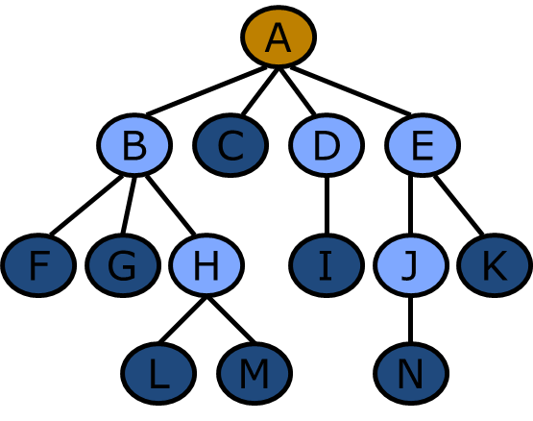
Recall: WHY TREES?
Model layouts with hierarchical relationships between items
Chain of command in the army
Personnel structure in a company
(Binary tree structure is limited because each node can have at most two children)
Tree structures also allow us to
Some problems require a tree structure: some games, most optimization problems, etc.
Allow us to do the following very quickly:
(we’ll see that in the following lectures)
Search for a node with a given value
Add a given value to a list
Delete a given value from a list

Slide 53
OUTLINE
Item Search
Binary Search Trees (BST)
BST Operations:
Traversal
Inserting a node
Removing a node
H
E
L
B
F
J
M
A
C
G
I
K
D

Slide 54
Item Search-linked list
inefficient
Given a linked list of names, how do we check whether a given name(e.g., Irit) is in the list?
John
Anna
Peter
Jane
Irit
Brian
Simon
cur
cur
cur
cur
cur
while (cur!=NULL) {
if cur->item == “Irit”
found and stop searching;
else
cur = cur->next; }
How many nodes are visited during search?
--best case: 1 node (John)
--worst case: 7 nodes (Simon)
--avg. case: (1+2+3+…+7)/7=4 nodes
Notes:
Item search-linked list
As per the given example in the slide, to search ‘Irit’ the ‘cur’ pointer points at nodes starting from index [0] until it points at ‘Irit’. How many nodes are visited during the search?
Best case: If we search for ‘john’, we have to point the ‘cur’ only once because ‘jhon’ is the first node. Therefore 1 node is the best case.
Worst case: Worst case happens if we search for ‘simon’. Then we have to go through whole list since ‘simon’ is in 7th node. Therefore 7 node is the worst case.
Average case is; (1+2+3+…+7) / 7 = 4 nodes

Slide 55
Item Search-linked list
inefficient
Given a binary tree of names, how do we check whether a given name(e.g., Brian) is in the tree?
Use the TreeTraversal (Pre-order) template, to check every node
Anna
cur
Irit
Brian
cur
cur
John
Peter
Simon
Jane
cur
TreeTraversal(Node N)
If N==NULL return;
if N.item=given_name return;
TreeTraversal(LeftChild);
TreeTraversal(RightChild);
Return;
cur
How many nodes are visited during search?
--best case: 1 node (Anna)
--worst case: 7 nodes (Jane)
--Avg. case: (1+2+3+…+7)/7=4 nodes
Notes:
Item search-linked list
As per the given example in the slide, to search ‘Irit’ the ‘cur’ pointer points at nodes starting from index [0] until it points at ‘Irit’. How many nodes are visited during the search?
Best case: If we search for ‘john’, we have to point the ‘cur’ only once because ‘jhon’ is the first node. Therefore 1 node is the best case.
Worst case: Worst case happens if we search for ‘simon’. Then we have to go through whole list since ‘simon’ is in 7th node. Therefore 7 node is the worst case.
Average case is; (1+2+3+…+7) / 7 = 4 nodes

Slide 56


Is there a way to organize the data so that item search can be more efficient?
What’s a good way to arrange data in our tree so that we can eﬃciently store and retrieve items?
How do we eﬃciently (minimize number of operations) ﬁnd an item in a binary tree?
Given a list of items, how do we check if some given item is contained inside?

Slide 57
John
Anna
Peter
Jane
Irit
Brian
Simon
For the list:
Sort it using alphabetical order:
Divide them into groups
Pick the one in the middle, “Jane”, if X!=“Jane”:
For names before “Jane”, lookup its left subgroup, ignore its right subgroup
Pick the one in the middle of the subgroup, “Brain”, if X!=“Brain”:
names before “Brian”, lookup its left subgroup
names after “Brian”, lookup its right subgroup
For names after “Jane”, lookup its right subgroup, ignore its left subgroup
Pick the one in the middle of the subgroup, “Peter”, if X!=“Peter”:
<“Peter”, lookup its left subgroup
>“Peter”, lookup its right subgroup
Search the given name X
Anna
Brian
Irit
Jane
John
Peter
Simon
Notes:
After sorting the given list in alphabetical order if we try to search a given name X;
We first have to divide the names into groups
We can pick a name from the middle; ‘Jane’ and check if X is ‘Jane’. If X!=’Jane’; the X should be in either jane’s left subgroup or in jane’s right subgroup.
If X is in jane’s left subgroup ; (For the names before jane)
Then again, we pick the middle name of the subgroup ‘Brian’ and check whether X is Brian. If not, we have to check whether to search Brian’s left subgroup or Brian’s right subgroup.
If X is in jane’s right subgroup. (For the names after jane)
We pick the middle name of the subgroup which is ‘peter’ and check whether X is Peter. If X is before peter we check with John. Otherwise, we check with Simon.
This is actually a binary search tree

Slide 58
It forms a Binary Search Tree (BST)
Divide them into groups
Pick the one in the middle, “Jane”, if X!=“Jane”:
For names before “Jane”, lookup its left subgroup, ignore its right subgroup
Pick the one in the middle of the subgroup, “Brain”, if X!=“Brain”:
names before “Brian”, lookup its left subgroup
names after “Brian”, lookup its right subgroup
For names after “Jane”, lookup its right subgroup, ignore its left subgroup
Pick the one in the middle of the subgroup, “Peter”, if X!=“Peter”:
<“Peter”, lookup its left subgroup
>“Peter”, lookup its right subgroup
Jane
Brian
Peter
Anna
Irit
John
Simon

Slide 59
OUTLINE
Item Search
Binary Search Trees (BST)
BST Operations:
Traversal
Inserting a node
Removing a node
H
E
L
B
F
J
M
A
C
G
I
K
D

Slide 60
Binary Search Tree(BST)
BSTs are a special form of BT
BST rule: At every node C, L < C < R, where
C is the data in the current node
L represents the data in any/ all nodes from C’s left subtree
R represents the data in any/all nodes from C’s right subtree
C
H
R
L
E
L
B
F
J
M
A
C
G
I
K
D
Notes:
Binary Search Tree - L< C< R

Slide 61
Binary Search Tree
BSTs are a special form of BT
At every node C, L <= C <= R, where
C is the data in the current node
L represents the data in any/ all nodes from C’s left subtree
R represents the data in any/all nodes from C’s right subtree
H
H
L
B
F
J
M
NO = in the BST!
There must be no duplicate nodes in BST!
A
B
G
I
K
D
This is not a BST!
Notes:
Binary Search Tree cannot have duplicate nodes.

Slide 62
BST is for efficient item search
This is a BST, satisfies ‘L < C < R’
Jane
Brian
Peter
Anna
Irit
John
Simon

Slide 63
BST is efficient for item search
5 nodes
John
Anna
Peter
Jane
Irit
Brian
Simon
Anna
Jane
5 nodes
2 nodes
Irit
Brian
Brian
Peter
John
Peter
Simon
Jane
Anna
Irit
John
Simon
How many nodes are visited during search?
--best case: 1 node (Anna)
--worst case: 7 nodes (Jane)
--Avg. case: (1+2+3+…+7)/7=4 nodes
How many nodes are visited during search?
--best case: 1 node (Jane)
--worst case: 3 nodes (Anna)
--Avg. case: (1+2*2+3*4)/7=2.43 nodes
Notes:
As per the given trees in the slide, the left sided tree is not a binary search tree because it is not satisfying the rule L < C< R. The right sided tree is a binary search tree.
If we want to search Irit; using a linkedlists we have to go through 5 nodes.
If we use a binary search tree, we can complete the search using 3 nodes.
First, the root node, ‘Jane’ is not equal to ‘Irit’. Since ‘I’ comes before ‘J’ in the alphabet, we have to search ‘Irit’ in Jane’s left subtree. Jane’s left subtree ‘Brian’ is not ‘Irit’.
‘I’ comes after ‘B’ therefore we have to search ‘Irit’ in Brian’s right subtree.
Then ‘Irit’ is equal to our request. Using the tree in the left side, if we want to search for Brian we have to go through 5 nodes. But using the binary search tree.
We can perform the search using 2 nodes. Binary search trees are more efficient for the item search.
Worst case of the given binary search tree is visiting 3 nodes because the given tree has 3 levels.

Slide 64
BST is efficient for item search
Anna
Efficient
inefficient
2 nodes
Jane
5 nodes
Irit
Brian
Brian
Peter
3 nodes
John
Peter
Simon
Jane
Anna
Irit
John
Simon
How many nodes are visited during search?
In general, for a BT with n nodes:
--best case: First node in traversal
--worst case: Last node in traversal, n
How many nodes are visited during search?
In general, for a BST with n nodes:
--best case: First node in traversal
--worst case:
leaf node: the height of the root + 1
Minimal height H = ⎣log₂n⎦
As n becomes a big number, the difference between them becomes even greater
Height of a node = number of links from that node to the deepest leaf node

Slide 65
How do we get Minimal H= ⎣log₂n⎦
For a tree with height H, we have:
n ≤ 2^{H+1} -1
where n is the size of the tree.
Tree Height ➔ H ≥ ⎣log₂n⎦
Minimal Height = ⎣log₂n⎦
Height of a node = number of links from that node to the deepest leaf node
D
B
E
A
C
D
F
Maximal size tree with H=2

Slide 66
Another BST
Efficient
H
E
L
B
F
J
M
A
C
G
I
K
D
inefficient
A
B
C
D
E
F
G
H
I
J
K
L
M
How do we check if a given item X is stored in the tree?
To find D, we need to visit H-E-B-C-D, 5 nodes.
To find any node in the tree, at most visit 5 nodes.
But for the linked list, the worst case need to visit all nodes - 13 nodes.

Slide 67
Notice: not all BST are efficient for search
What does a good/bad BST look like?
Two possible BST representations of the list
A
D
B
B
E
C
A
C
F
D
H=5
inefficient
H=2
E
F
Notes:
Not all binary search trees are efficient for searches.
For an example, between the given two trees in the slides the left sided tree is a binary search tree with h=2 and efficient for search.
But the right sided tree which is also a binary search tree because it satisfy the rules, is not efficient.

Slide 68
















RECALL: Number game [1, 15]
How many questions do you ask to guess the number?
Best case: 1 question
Worst case: 4 questions
Q0
Efficient
8 ?
<
>
Q1
4?
Q2
12 ?
<
>
<
>
Q3
2 ?
Q4
6 ?
Q5
10 ?
Q6
14 ?
<
>
<
>
<
>
<
>
1
3
5
7
9
11
13
15
Q7
Q8
Q9
Q10
Q11
Q12
Q13
Q14
2
4
6
10
12
14
1
8
15
Notes:
According to the game which we discussed in last lecture where we asked several questions to guess a number between 1 and 15, we formed a binary search tree,
We have picked the middle number of the range of 1-15 which is 8 and check if it is the correct number.
`
If it is not correct, we hacked whether the correct number is larger than to 8 or smaller than to 8. If it is smaller than 8.
We pick the range of 1-8 and get the middle of that range which is 4 and if 4 is not the correct answer we again checked whether the correct number is larger than 4 or smaller than 4 likewise we can continue the questions until we get the correct number.
If the correct number is 8, we need to ask only one question. This is the best case.
If the correct number is 1, 3, 5, 7, 9, 11, 13, or 15 we need to ask 4 questions. This is the worst case.
This is an efficient method to search.

Slide 69
RECALL: Number game [1, 15]
How many questions do you ask to guess the number?
If the strategy is to guess 1 first, and then 2, 3, …, 15
Best case: 1 question
Worst case: 15 questions
inefficient
2
4
6
10
12
14
1
8
15

Slide 70
Exercise: Which Binary Trees is efficient for search ?
H
E
L
B
F
J
M
A
C
G
I
K
G
D
B
I
E
F
J
K
A
C
H
L
M
D

Slide 71
Think: What is the visiting sequence using In-order Traversal for a BST?
E
H
E
B
G
E
L
A
C
F
I
B
F
J
M
D
H
A
C
G
I
K
D
Output:
A
B
C
D
E
F
G
H
I
?
Notes:
For the given first tree using in-order traversal we can output the sequence as;
A, B, C, D, E, F, G, H and I

Slide 72
Mapping: tree(In-order) → list
<
H
>
<
E
>
<
L
>
B
>
F
>
<
J
>
M
<
A
C
>
G
I
K
D
A
B
C
D
E
F
G
H
I
J
K
L
M
If we draw the BST carefully:
Left subtree on the left side of the current node;
Right subtree on the right side of the current node;
Mapping to X-axis will produce a sorted list.
Notes:
We get a sorted linkedlist if we flatten a binary search tree because we can map binary search tree into a linkedlist as shown in the slide.

Slide 73
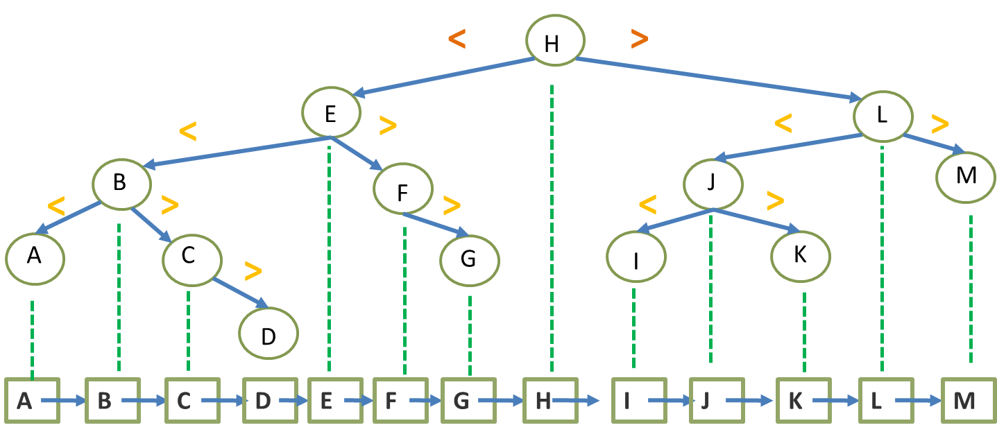
Features
L < C < R rule ensures sorted order
BST’s in­‐order traversal produces a sorted list!

Slide 74
Features
The binary-search-tree property guarantees that:
The minimum is located at the left-most node
The maximum is located at the right-most node
M
A

Slide 75
OUTLINE
Item Search
Binary Search Trees (BST)
BST Operations:
Traversal
Inserting a node
Removing a node
H
E
L
B
F
J
M
A
C
G
I
K
D

Slide 76
Binary Search Tree(BST)
BSTs are a special form of BT
BST rule: At every node C, L < C < R, where
C is the data in the current node
L represents the data in any/ all nodes from C’s left subtree
R represents the data in any/all nodes from C’s right subtree
C
H
R
L
E
L
B
F
J
M
A
C
G
I
K
D
Notes:
Binary Search Tree - L< C< R

Slide 77
BST Traversal (BSTT)
BSTT() traverses a BST to search for a node with a matching item
Begin with TreeTraversal template
H
E
L
B
F
J
M
A
C
G
I
K
void BSTT(BTNode *cur, char c){
if (cur == NULL) return;
// Do something
BSTT(cur->left);
BSTT(cur->right);
}
D
Do something with the current node’s data
Visit the left child node
Visit the right child node
Notes:
Binary Search Tree - L< C< R

Slide 78
BST Traversal (BSTT)
Now, at each node, we need to determine which subtree to keep visiting (and which subtree to ignore)
H
E
L
B
F
J
M
A
C
G
I
K
void BSTT(BTNode *cur, char c){
if (cur == NULL) return;
if (c==cur->item)
{ printf(“found!\n”); return;}
if (c < cur->item)
BSTT(cur->left,c);
else
BSTT(cur->right,c);
}
D
Do something with the current node’s data
Visit the left child node
Visit the right child node
Notes:
BST Traversal
Using the tree traversal template we can construct the code for BST Traversal.
After defining the function ‘BSTT’ with a btnode typed pointer and a character typed variable we first check whether the current node is NULL or NOT NULL.
void BSTT ()btnode *cur, char C){
if (cur==NULL) return;
}
If current node is NOT NULL, we check whether the pointer ‘cur’ points at the required node. If ‘yes’ we output a massage and return.
if (c==cur -> item) {
printf (“found!\n”); return;
}
If the current node is not what we required we check whether C is less than the current item. If it is less than current item, it should be in current item’s left subtree. Therefore we have to move to the left child node.
if (c< cur -> item)
BSTT ( cur -> left, C);
Else we have to check the right sub tree.
else
BSTT (cur -> right, C);

Slide 79
BST Traversal (BSTT)
Check the traversal pattern for BSTT(root, ‘B’)
‘B’ < ‘H’
H
E
L
‘B’ < ‘E’
B
F
J
M
A
C
G
I
K
void BSTT(BTNode *cur, char c){
if (cur == NULL) return;
if (c==cur->item)
{ printf(“found!\n”); return;}
if (c < cur->item)
BSTT(cur->left,c);
else
BSTT(cur->right,c);
}
D
Notes:
For an example, if you want search for ‘B’ in the given binary search tree;
You start with ‘H’ which is the root node.
Check whether ‘H’ is what we are searching for. Since we are searching for ‘B’, ‘H’ is not the correct node.
Then we check whether ‘B’ is less than ‘H’. ‘B’ comes before ‘H’ in the alphabet. Therefore ‘B’ < ‘H’. Then we move to the left subtree of ‘H’, which is ‘E’.
We now check again whether ‘E’ is what we are searching for. Since ‘E’ is not what we want we check whether ‘B’ is less than ‘E’. Since ‘B’ comes before ‘E’ in the alphabet, ‘B’ < ‘E’ Therefore we move to the left child node of ‘E’ which is ‘B’.
Now we check whether ‘B’ is what we are searching for. Since the answer is ‘yes’, we can print the massage.

Slide 80
BST Traversal (BSTT)
Check the traversal pattern for BSTT(root, ‘K’)
H
‘K’ > ‘H’
E
L
‘K’ > ‘L’
B
F
J
M
‘K’ > ‘J’
A
C
G
I
K
void BSTT(BTNode *cur, char c){
if (cur == NULL) return;
if (c==cur->item)
{ printf(“found!\n”); return;}
if (c < cur->item)
BSTT(cur->left,c);
else
BSTT(cur->right,c);
}
D
Notes:
Same process should follow to search node ‘K’.
This time ‘K’ comes after ‘H’ in the alphabet ‘K’ is large than ‘H’.
Therefore we have to check with right subtree of ‘H’ this time.

Slide 81
BST Traversal (BSTT) – finding ‘b’
void BSTT(BTNode *cur, char c){
if (cur == NULL) return;
if (c==cur->item){
printf(“found!\n”); return;
}
if (c < cur->item)
BSTT(cur->left,c);
else
BSTT(cur->right,c);
}
H
E
L
B
F
J
M
void BSTT(BTNode *cur, char c){
if (cur == NULL) return;
if (c==cur->item){
printf(“found!\n”); return;
}
if (c < cur->item)
BSTT(cur->left,c);
else
BSTT(cur->right,c);
}
void BSTT(BTNode *cur, char c){
if (cur == NULL) return;
if (c==cur->item){
printf(“found!\n”); return;
}
if (c < cur->item)
BSTT(cur->left,c);
else
BSTT(cur->right,c);
}
Found!

Slide 82
BST Traversal (BSTT)
void BSTT(BTNode *cur, char c){
if (cur == NULL) {
printf(“can’t find!”);
return;
}
if (c==cur->item)
{
printf(“found!\n”);
return;
}
if (c < cur->item)
BSTT(cur->left,c);
else
BSTT(cur->right,c);
}
‘D’ < ‘H’
H
E
L
‘D’ < ‘E’
B
F
J
M
‘D’ > ‘B’
A
C
G
I
K
‘D’ > ‘C’
What if the item doesn’t exist?
If we remove node ‘D’, and then check the traversal pattern
Notes:
What if we remove node ‘D’ and search for it?
We start from the root node ‘H’ and follow the discussed process until ‘C’.
Now ‘D’ is larger than ‘C’. Therefore we move from ‘C’ to its right child node.
Now the pointer points at an empty node because we have already removed ‘D.
Therefore cur==NULL, and we can print a massage.
if (cur== NULL) { printf (“can’t find!”); return; }

Slide 83
BST Traversal (BSTT) – finding ‘A’
void BSTT(BTNode *cur, char c){
if (cur == NULL){
printf(“not found!\n”); return;
}
if (c==cur->item){
printf(“found!\n”); return;
}
if (c < cur->item)
BSTT(cur->left,c);
else
BSTT(cur->right,c);
}
H
E
L
B
F
J
M
Not Found!
void BSTT(BTNode *cur, char c){
if (cur == NULL){
printf(“not found!\n”); return;
}
if (c==cur->item){
printf(“found!\n”); return;
}
if (c < cur->item)
BSTT(cur->left,c);
else
BSTT(cur->right,c);
}
void BSTT(BTNode *cur, char c){
if (cur == NULL){
printf(“not found!\n”); return;
}
if (c==cur->item){
printf(“found!\n”); return;
}
if (c < cur->item)
BSTT(cur->left,c);
else
BSTT(cur->right,c);
}
void BSTT(BTNode *cur, char c){
if (cur == NULL){
printf(“not found!\n”); return;
}
if (c==cur->item){
printf(“found!\n”); return;
}
if (c < cur->item)
BSTT(cur->left,c);
else
BSTT(cur->right,c);
}

Slide 84
OUTLINE
Item Search
Binary Search Trees (BST)
BST Operations:
Traversal
Inserting a node
Removing a node
H
E
L
B
F
J
M
A
C
G
I
K
D

Slide 85
Inserting a node into a BST
Given an existing BST, an insertion operation must result in a BST
How do we know where to place a new node ‘D’?
H
E
L
B
F
J
M
A
C
G
I
K
D
Notes:
For the given binary search tree in the slide we try to insert node ‘D’ and still maintain the tree as a binary search tree.

Slide 86
Inserting a node into a BST
Key point:
Given an existing BST and a new value to store, there is always a unique position for the new value
H
E
L
B
F
J
M
A
C
G
I
K
D
Notes:
There is only one unique position a node can be inserted in. Therefore there is only one answer.

Slide 87
Inserting a node into a BST
Use BSTT() to get to the correct empty location
Add the new node
H
E
L
B
F
J
M
A
C
G
I
K
D
Notes:
Before inserting the node we use Binary Tree Traversal Template to identify the correct empty location for the node.

Slide 88
Inserting a node into a BST
Use BSTT(root, ‘D’) to get to the correct empty location to insert ‘D’
Add the new node ‘D’
‘D’ < ‘H’
H
E
L
‘D’ < ‘E’
B
F
J
M
‘D’ > ‘B’
A
C
G
I
K
‘D’ > ‘C’
D
Notes:
Since we are trying to insert node ‘D’.
We first traverse the tree for node ‘D’.
Once we found that ‘D’ should be inserted as the right child node of ‘C’ because ‘D’ is larger than ‘C’.
We can add the node to the BST.

Slide 89
Inserting a node into a BST
Node insertion is relatively simple!
Further exercise: Try Inserting ‘Z’
H
E
L
B
F
J
M
A
C
G
I
K
Z

Slide 90
Inserting a node into a BST
Node insertion is relatively simple!
Further exercise: Try Inserting ‘Z’
H
E
L
B
F
J
M
A
C
G
I
K
Z
Q

Slide 91
OUTLINE
Item Search
Binary Search Trees (BST)
BST Operations:
Traversal
Inserting a node
Removing a node
After removal, the tree is still a BST
H
E
L
B
F
J
M
A
C
G
I
K
D

Slide 92
Removing a node from a BST
Node removal is more complicated
Beginning with a BST, the resulting tree after removing a node must still be a BST
Obey the BST rule: L < C < R

Slide 93
Removing a node from a BST
Remove node X - a bit tricky
3 cases:
x has no children:
Remove x
x has one child y:
Replace x with y
x has two children:
Swap x with successor
Perform case 1 or 2 to remove it
H
E
L
B
F
J
M
A
C
G
I
K
D
Notes:
There are 3 cases we should consider when we try to remove a node from a BST.

Slide 94
Removing a node from a BST
Remove node X - a bit tricky
3 cases:
x has no children:
Remove x
x has one child y:
Replace x with y
x has two children:
Swap x with successor
Perform case 1 or 2 to remove it
H
E
L
B
F
J
M
A
C
G
I
K
D
Notes:
Case 1: X has no children
If the node which we are trying to remove has no children, or in other world, if we are trying to remove a leaf node, we can just remove the node and the remaining tree is still a BST.

Slide 95
Removing a node from a BST
Remove node X - a bit tricky
3 cases:
x has no children:
Remove x
x has one child y:
Replace x with y
x has two children:
Swap x with successor
Perform case 1 or 2 to remove it
H
E
L
B
F
J
A
C
G
I
K
D
Notes:
Case 2: If X has one child Y
The nodes coloured in ‘pink’ in the slide has only one child node.
For an example if we want to remove node ‘F’ from the BST, we can replace node ‘F’ with node ‘G’ because ‘F’ has only one child which is ‘G’.
Same logic can be applied to node ‘L’ and node ‘C’. ‘L’ can be replaced with ‘J’ and ‘C’ and be replaced with ‘D’.

Slide 96
Removing a node from a BST
Remove node X - a bit tricky
3 cases:
x has no children:
Remove x
x has one child y:
Replace x with y
x has two children:
Swap x with successor
Perform case 1 or 2 to remove it
H
E
L
B
F
J
M
A
C
G
I
K
D
Notes:
Case 3: When X has two children
This case is little bit complicated.

Slide 97
What is the successor of X?
Replacing a node with its in-order successor ensures that the BST rule (L<C<R) is maintained
In-order traversal of a BST produce a sorted list (in ascending order)
Successor is:
The node immediately after it in the sorted list, or
The next node visited using an in‐order traversal
X has two children, so X’s successor is minimum node in its right subtree.
E.g.: H’s successor is I, E’s successor is F, J’s successor is K.
H
I
Notes:
What is successor of X?
For an example, in the given tree, the successor of ‘H’ is ‘I’, because ‘I’ comes immediately after ‘H’ in the sorted list. ‘I’ is the node visited after ‘H’ using in-order traversal also.
Now we have to swap ‘H’ with ‘I’ if we want to remove ‘H’, because if we replace the node with its in-order successor, it ensures the BST rule (L < C < R) is maintained.
Therefore, first we swap ‘H’ with ‘I’ and then ‘H’ become a leaf node. Now we can apply case 1 which we discussed and remove ‘H’.
Now the BST rule is maintained as before.

Slide 98
Removing a node from a BST
Remove node X - a bit tricky
3 cases:
x has no children:
Remove x
x has one child y:
Replace x with y
x has two children:
Swap x with successor
Perform case 1 or 2 to remove it
Remove H
Remove E
H
E
L
B
F
J
M
A
C
G
I
K
D
Notes:
As discussed in the previous slide, if we want to remove node X which has two children;
First, we swap X with its successor
Then perform case 1 or case 2 to remove X.

Slide 99
Questions
Why will case 3 always go to case 1 or case 2?
A: because when X has 2 children, its successor is the minimum in its right subtree, so the successor should not have left child.
It might have no child(case 1) or one right child(case 2).
Could we swap x with predecessor instead of successor?
A: yes.

Slide 100
Removing a node from a BST
Remove node X - a bit tricky
3 cases:
x has no children:
Remove x
x has one child y:
Replace x with y
x has two children:
Swap x with successor
Perform case 1 or 2 to remove it
H
E
L
B
F
J
M
A
C
G
I
K
D
Notes:
The node immediately after it in the sorted list, or
The next node visited using an in‐order traversal
X has two children, so X’s successor is minimum node in its right subtree.

Slide 101
What is the successor of X?
Replacing a node with its in-order predecessor ensures that the BST rule (L<C<R) is maintained
In-order traversal of a BST produce a sorted list (in ascending order)
Successor/predecessor:
The node immediately after/before it in the sorted list
The next/previous node visited using an in‐order traversal
X has two children, so X’s predecessor is maximum node in its left subtree.
E.g.: H’s predecessor is G, E’s predecessor is D, J’s predecessor is I.
H
G
H
G
Notes:
We can swap X with its predecessor instead of the successor as well.

Slide 102
Today you should be able to
Define a Binary Search Tree
From a list, how do we construct a Binary Search Tree? Is it efficient?
How do we traverse a BST to search a item?
How do we insert/remove a node from a BST?

